Slide 1


Slide 2

Who are we?
Hereford based apprenticeship training provider.
We offer apprenticeships within a wide and interesting range of employers across Herefordshire and Nationally.
Our Mission
To unlock every learner’s full potential
Our Values
PRIDE
TEAMWORK
STRIVING FOR EXCELLENCE
QUALITY
Notes:
PRIDE
We are passionate about what we do, take responsibility and find solutions
TEAMWORK
Together we can enjoy, inspire and achieve
STRIVING FOR EXCELLENCE
We invest in staff development, continuous improvement, innovation and efficiency
QUALITY
We are committed to excellence and achieving the highest standards

Slide 3
What is an apprenticeship?
EARN WHILE YOU LEARN
Combine practical training in a job with study
Get time for training and study related to your role (at least 20% of your normal working hours)
Be an employee
Work alongside experienced staff
Gain job specific skills
Set yourself up for the future – potential to progress onto higher level apprenticeships

Slide 4
Who’s completed an apprenticeship?
Jamie Oliver
The Naked Chef started his career as an Apprentice at Westminster Catering College before working in some of the top restaurants and ultimately opening his own and establishing a hugely successful TV and publishing career. He now offers Apprenticeships in several of his restaurants.
David Beckham
One of England’s most famous footballers and a real brand icon, on a world wide basis, actually signed on as an Apprentice with Manchester United in 1991. He’s done rather well ever since.
Karen Millen
Designer Karen Millen took an Apprenticeship course in fashion and later achieved huge success in the fashion business, eventually selling her chain of 130 stores across the globe.

Slide 5






Who we work with

Slide 6
What apprenticeships do we offer?
Business Administration
Digital Marketing
Customer Services
Financial services & AAT
Human Resources
Dental Nurse
Childcare – Early Years Practitioner/Educator
Teaching Assistant
Community Sport and Health Officer (PE Apprenticeship)
Name | Level | Equivalent to
Intermediate | 2 | 5 GCSE passes at grade A*-C
Advanced | 3 | 2 A level Passes/ level 3 diploma

Slide 7
Recruitment process and how to apply
Numerous ways to obtain a position
Apply for a position through the website or contact Riverside for help finding a position
CV help & Interview Practice
Invite to interview
https://riverside-training.co.uk/apprenticeship-vacancies/

Slide 8
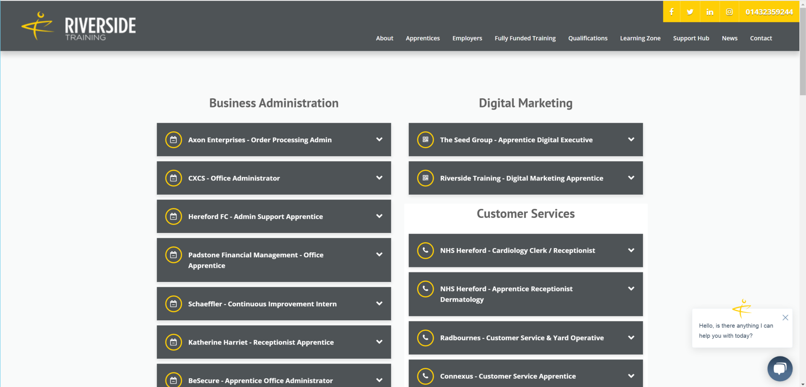
How to apply

Slide 9
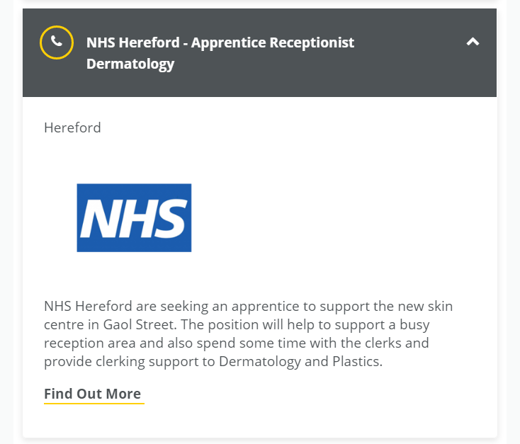
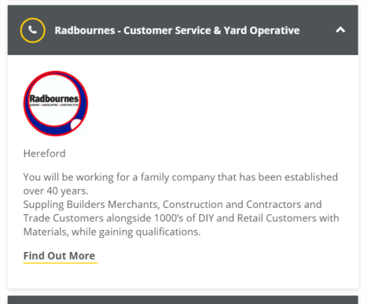
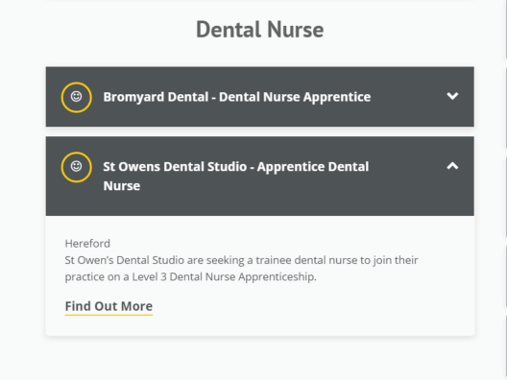

Slide 10
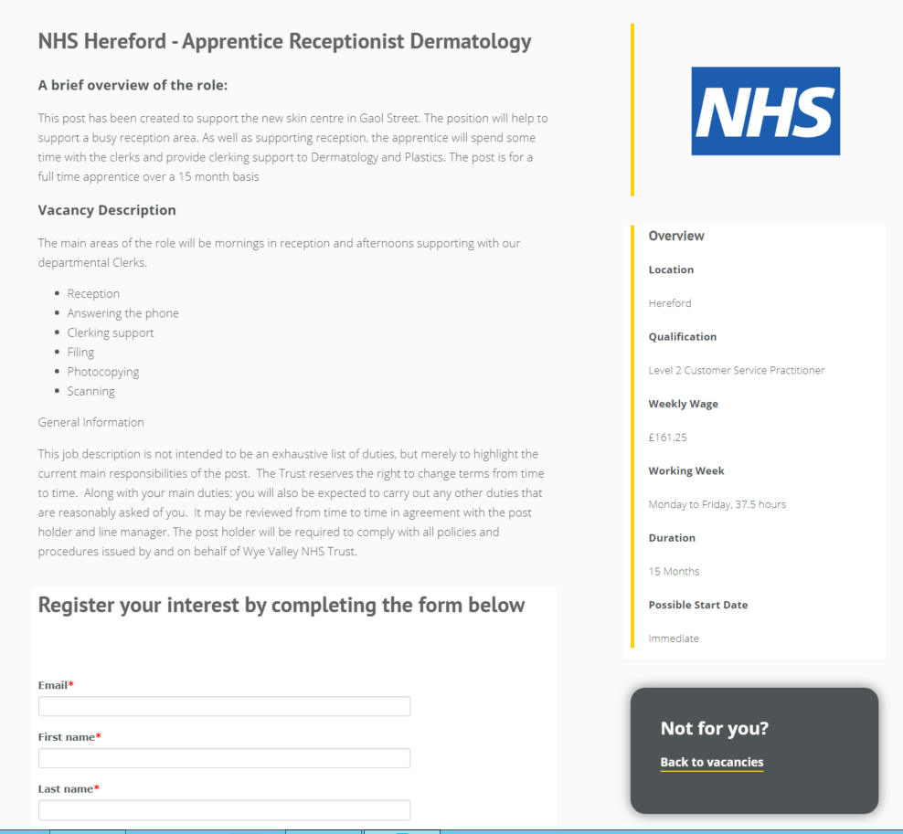

Slide 11
Your apprenticeship
Monthly Teach Sessions with your Learning and Development Coach (LDC)
1-2-1 support throughout
Learning support available
Mental health support available
All work submitted through BUD, our online learning platform.
Apprenticeship will last between 12-18 Months depending on the course

Slide 12
Are there entry requirements?
There are no strict entry requirements for starting an Apprenticeship.
Some employers may advertise their own entry requirements.
We can offer help and support to complete your Functional Skills Level 2 English and Maths, as a Level 2 (GCSE) is required to complete your apprenticeship
ADVICE- Pass your English and Maths!!

Slide 13
Additional Support
CV Advice
Interview Practice
English and Maths Functional Skills
Bee Inspired – Mental Health Support

Slide 14
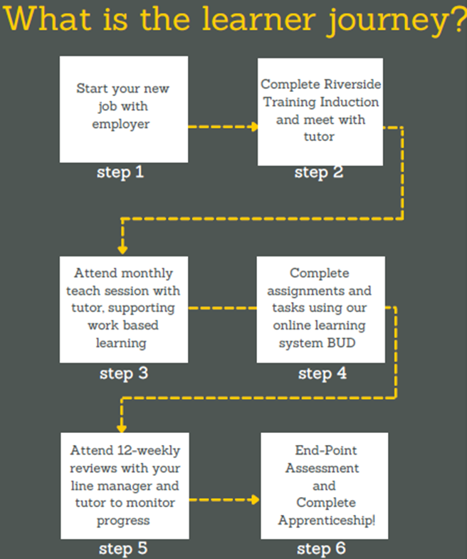

Slide 15
Example End Point Assessment
Community Sport and Health Officer (Level 3)- PE Apprentice
Work Based Observations
Case Study Challenge
Presentation
Panel interview

Slide 16
Riverside Training
4-6 St Martins Street, Hereford
Call - 01432 359244
Email- Rebecca@riverside-training.co.uk
Website-https://riverside-training.co.uk/
Social Media:
Riverside Training – Facebook, Instagram, Twitter

